Slide 1
District 5 Task Force
Why are we going through this process?

Slide 2
Why does this task force exist?
The resolution #2 as approved by the 2022 District 5 Lodge Meeting is as follows:
THEREFORE, be it resolved that the 2022-2024 District President shall appoint a Special Committee consisting of but not limited to current District Board members, past District Board members and District Members at large. The committee shall meet during the next biennium and present a recommendation of proposed solutions at the District Lodge meeting in June 2024. The Task Force should include diversification of selected appointees to include past, present, younger, older, different genders and from distant geographical areas that includes a more all-inclusive demographic appointee (s).

Slide 3
Task Force Members
PAUL | ABELQUIST
MATTHEW | AGEN
CONNIE | AIELLO
DAVID & RUTH | AMUNDSON
NANCY | ANDERSEN
NANCY | ANDERSON
DARLENE | ARNESON
CORLENE | BARTELS
EILEEN | BELOW
DOROTHY | BERG
SUE | BERG-ROEDEL
GRETCHEN | BJORK
VEE | BJORNSON
CLARK | BREKKE
KAREN | BRINKMAN
KAREN | BROADHEAD
BRENT | BRYE
BILL | BULTINCK
DEE | BUMPERS
ESTHER | CHARLETON
MICHAELA | DECKER
ERIK | DUUS
KAREN | EBERHARDT
ELIAS | ELLEFSON
JOANNE | ERICKSON
CHRISTINA | FAIRCHILD
OLGA | FAST
DAVID | FISCHER
ROBIN | FOSSUM
DOUGLAS | FRAMNESS
SHERRI | FREELS
JUDY | GHASTIN
VICKI | GOPLEN
JON | GRINDE
DAWN | GUNDERSON
CHRISTINE | GUTSCH
ROGER | HANSON
MERLE | HANSON
LEE ANN | HARP
DARLENE | HENDERSON
JIM | HERMAN
DAVID | HIRSCHEY
ROGER | INSTENES
ADRIAN | JOHNSON
KEN | JOHNSON
JANET | JOHNSON
BARB | JOHNSON
DIXIE | JORNES
KAREN | KENNEDY
ALAN | KJERNES
OSCAR | KROSNES
CONNIE | KROSS
ARLENE | KRUEGER
ROBERTA | LOUISON
THOMAS | MAXSON
SUSAN | MORTON
ARNO | MORTON
STEVEN | MUNKVOLD
MAREN | NELSON
BETH | NELSON
JOAN | O'BRYAN
BRIAN | OGNE
DON | OLSON
ROBIN | ØYE
MIKE | PALECEK
PEGGY | PARKER
AUDREY | PARRETT
NANCY | ROBINSON
JERRY | RUD
VICKI | RUDH-JONES
KAREN | SCHAAF
PEGGY | SCHROEDER
WILLIAM | SCHRUBA
KATHY | SECORA
AUDREY | SEVERSON
HARLEY | SKJERVEM
SUSAN | SOLLI
WAYNE | STORDAHL
GAIL | TAGGERT
JEANETTE | THOMPSON
HALEY | VINGNESS
DENNIS | WESTGOR
CHERYL | WOLOHAN
SALLIE | WYLIE

Slide 4
Purpose of SON District
The district lodge shall promote the interests of SON within the district and shall cooperate with and assist the local lodges and its officers and directors in their work, both relation to fraternal activities and organization work.
SON lodges are divided into geographical districts, each of which are assigned local lodges.
District lodges contain at least 3,000 members.
District lodges may be further divided into several geographical zones for administrative purposes.
District board of directors (BOD) are responsible for assisting local lodges and its members.

Slide 5
Sub Committees- they need your ideas!
Population and membership- using maps and membership lists to get a geographical and membership numbers view of our District.
JUDY | GHASTIN | Appleton | WI | 920-450-3584 | judy62ghastin@gmail.com
JIM | HERMAN | Cincinnati | OH | 513-919-5218 | jpherman.edvardgrieg@gmail.com

Slide 6
Current ways to support lodges- what can we do in the meantime to support lodges?
DARLENE | ARNESON | Stoughton | WI | 608-514-4951 | arnesonfamily5@gmail.com
DAVID & RUTH | AMUNDSON | Westby | WI | 608-634-3034 | nissedal@mwt.net

Slide 7
Role of the Board- Board Structure- What do board members do? What can be done virtual vs. in-person? Role of the various board members and officers.
CLARK | BREKKE | Farragut | TN | 865-966-0608 | cjbrekke@gmail.com
ESTHER | CHARLETON | Cincinnati | OH | 513-923-3798 | esthersofn@aol.com

Slide 8
How does the District Board do its job?
Board members are assigned by the district president to mentor local lodges in their vicinity (within a ZONE)
Visit lodges
Attend lodge events
Be available to help with questions from members
Provide leadership training
Board members serve in officer positions such as president, vice president, secretary, treasurer, youth director, publicity director, cultural director and sports & recreation director.
Currently district 5 has six (6) zones. There are two BOD members assigned to each zone which are referred to as zone directors. The zone directors may also hold an officer position which require additional duties for the district in general.

Slide 9
The Current way our District is organized

Slide 10
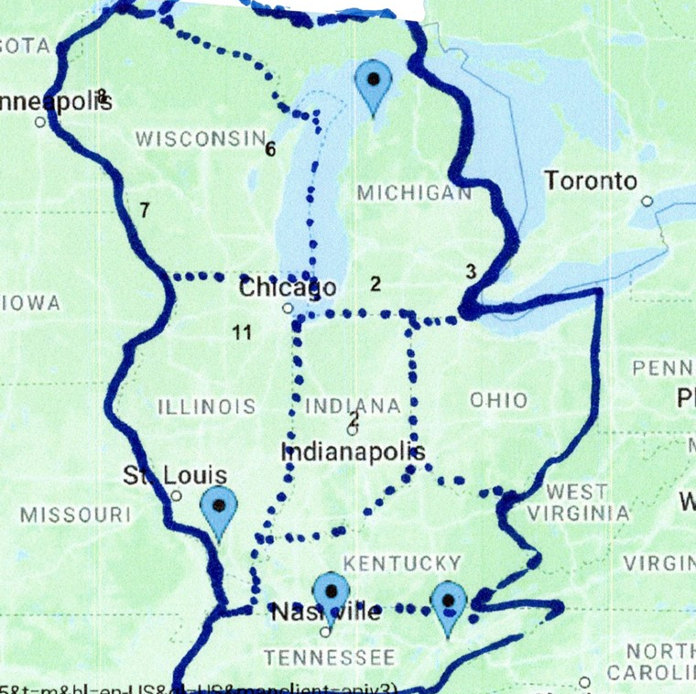

Slide 11
Some options that we are considering and need your input on!

Slide 12
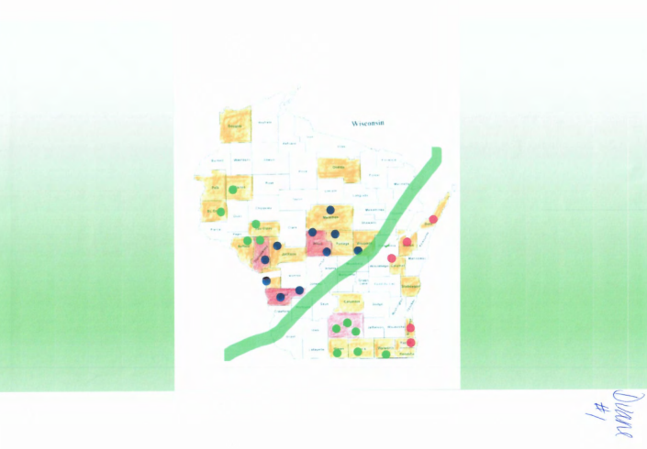

Slide 13
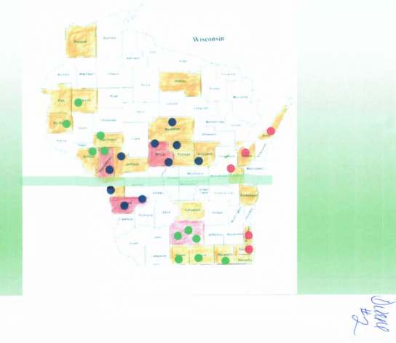

Slide 14
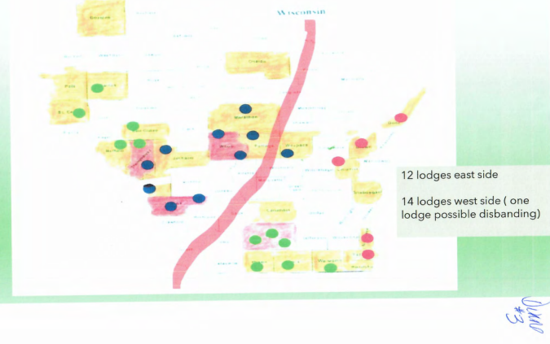

Slide 15
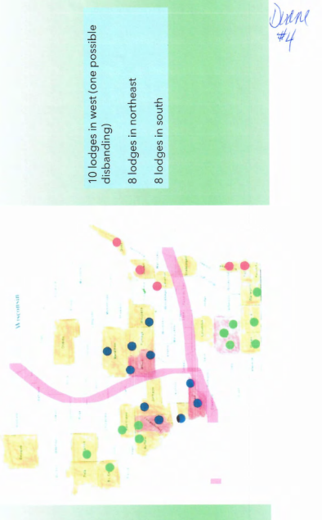

Slide 16
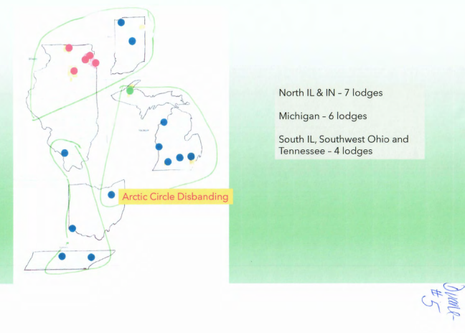

Slide 17
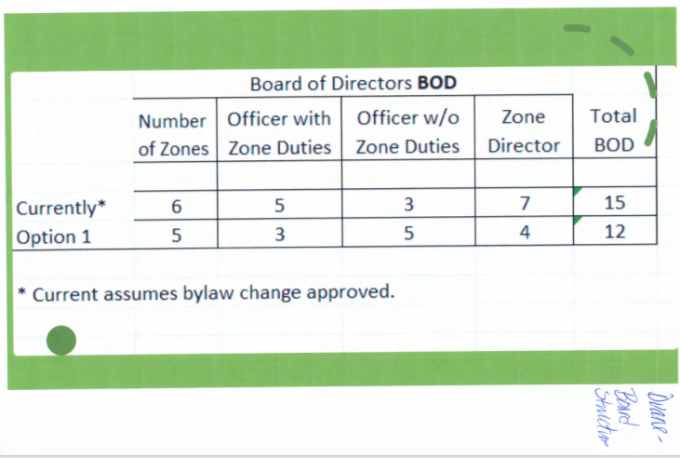

Slide 18
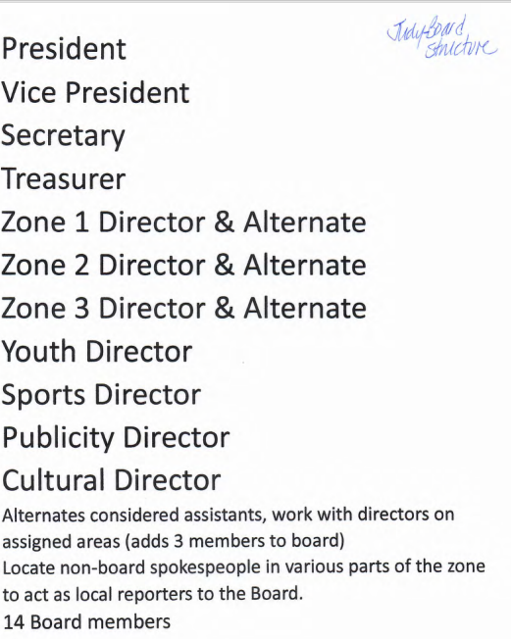

Slide 19
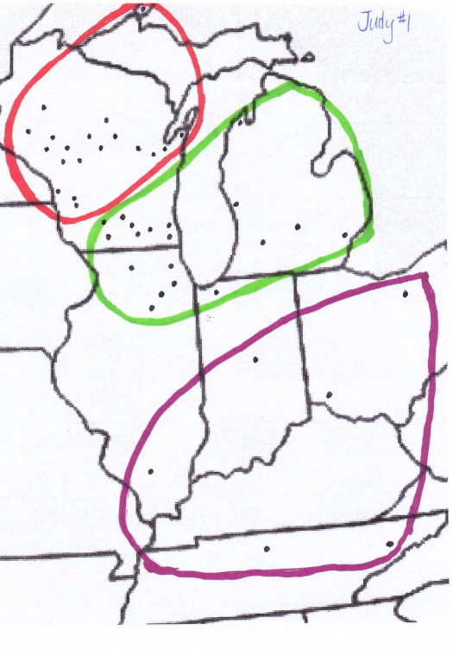

Slide 20
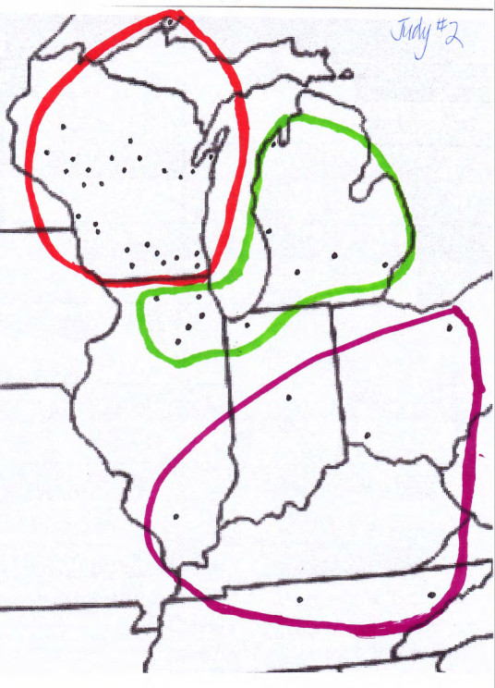

Slide 21
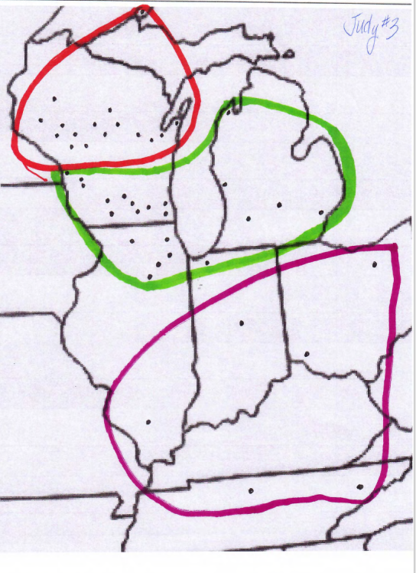

Slide 22
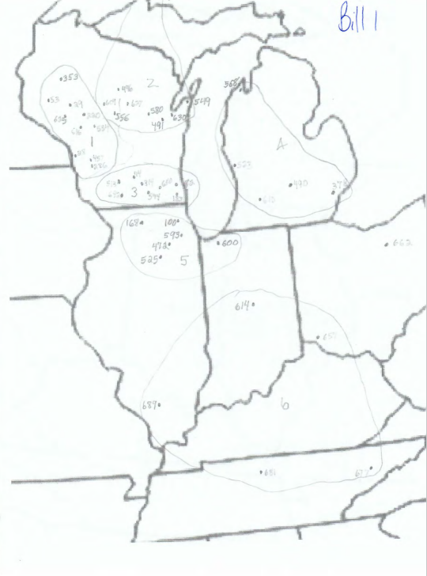

Slide 23
What if
The number of Zones would be reduced?
East Wisconsin
West Wisconsin
North IL & IN
All Michigan
South IL, Southwest Ohio and TN
More of the officer positions were relieved from zone director responsibilities?
President, VP, Secretary, Treasurer & Youth Director all at large with no zone responsibilities
Cultural, Publicity, and Sports & Recreation Directors retain zone responsibilities.
Benefit member status could be eliminated for all District Board members?

Slide 24
I've invited you to fill out a form:
Click on the link below (SN D5 Task Force May Survey)
SN D5 Task Force May Survey
Please send your thoughts on zones so the District 5 Task Force and Board can review them. Please input your responses by using this survey for discussion at our next meeting. The online, email and hard copies surveys will close on August 1. The District 5 Task Force will use your responses in their report to the Board. Send them to arnesonfamily5@gmail.com.
Please fill it out via Google Survey!

Slide 25
Task Force Survey May 2023
Please send your thoughts on zones so the District 5 Task Force and Board can review them. Please email your responses to Darlene Arneson by May 27 for discussion at our next meeting. The online, email and hard copies surveys will close on August 1. The District 5 Task Force will use your responses in their report to the Board. Send them to arnesonfamily5@gmail.com.
Thank you!
Darlene Arneson, District 5 Secretary and Chair (Zone Alignments and Lodge Development & Support Committee

Slide 26
What do you expect from your zone directors as far as visits, contacts, or other help?
___ Visit once a year
___ Hosting zone meetings or events
___ Regular communications via email, virtual platforms, or phone calls
___ In-person visits
___ Assistance with forms and filings
Other:

Slide 27
Do you feel connected to the other lodges in your zone?
___ Yes- we do many things with other lodges.
___ We have limited dealings with other lodges.
___ We never get together or work with them.
___ I’d like to have leadership training provided.
___ I’d like to see more social or cultural events.
Other:

Slide 28
Looking at the distance between some lodges and where the zone directors live, what suggestions do you have for addressing communications/visits/outreach in some areas?
___ Meeting via a virtual platform (ZOOM, TEAMS) is fine.
___ I’d like to have some in-person events.
___ I’d like to have some monthly/quarterly opportunities to meet.
___ I’d like to have in-person training at least once a year.
Other:

Slide 29
Do you have any suggestions for realignment, changing the number of zones, or other ways that would make the zone assignments equal in numbers, distance and services provided by the District Board.
___ I’ve reviewed the maps and think that some look like they’d work well.
___ I want to leave the zones as they are.
___ I don’t think we need zones at all.
Other:

Slide 30
For the structure of the District Board
___ I like the structure as it is- 2 zone directors per zone, all officers except Secretary and Treasurer are zone directors.
___ I don’t think any officer should be a zone director.
___ One zone director is enough.
___ Elect an Executive Committee and then one zone director per zone.
___ I think the number of zone directors should be based on the number of lodges.
___ I think the number of zone directors should be based on the membership in the zone.
Other:

Slide 31
Other thoughts or comments!

Slide 32
We need your help and input!
Discuss the PowerPoint, survey and maps at your lodge meetings.
Discuss with your zone director or task force members
Fill out the survey online or hard copy

Slide 33
Timeline for Task Force
August 1- close the surveys
August 5- Task Force Conference Call
By October 13-14 Board meeting- develop a plan and proposal
After October Board meeting, discuss the proposals with the District via ZOOM calls, zone meetings and events, lodge visits and other ways
By end of year- send out a bylaw proposal to 2022 District Delegates who are the District 5 Lodge Members

Slide 34
Prepared by Darlene Arneson
District 5 Secretary
Task Force Acting Chair
Chair- District zone Alignment & Lodge Development and Support Committee

