Slide 1
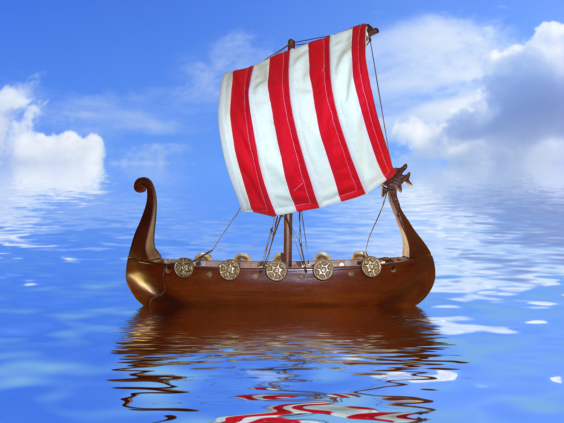
Contents- *Thoughts to share from Doris Kamstra at Sons of Norway International * What’s Working Currently and Tweaks to Consider * Idea Sharing
District 5
Lodge Reopening

Slide 2
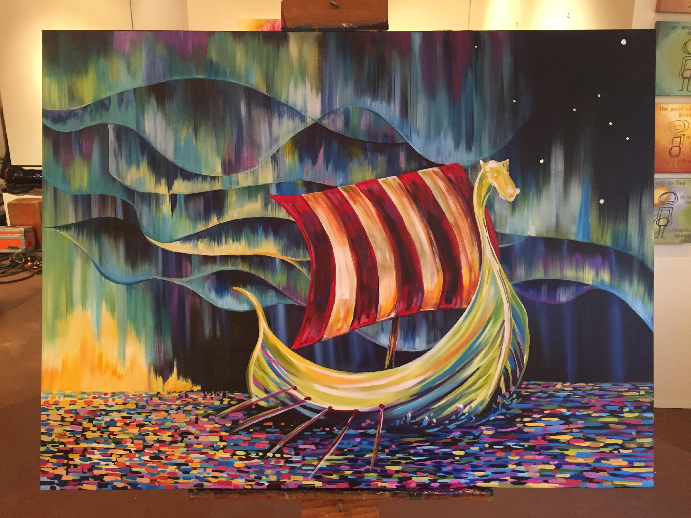
Uncharted Waters: Tactics to engage & retain members in the COVID era

Slide 3
There’s no need to rush…Oslo wasn’t built in a day!
Choose a reopening event:
A lodge picnic brings members together.
Light a bonfire or opt for night sky viewing with a local astronomy group or university professor.
Hold a concert.
Hire live music.
Schedule a movie or TV series for viewing.
Take a field excursion to a Norsk venue (Livsreise in Stoughton, WI, the Norsk Museum in Norway, IL, Norskedalen, rural Coon Valley, WI
Visit a winery, brewpub or distillery.
Learn the job of a coffee roaster.
Take a dinner cruise on a local lake.
ADVERTISE YOUR EVENT IN LOCAL MEDIA OUTLETS, INCLUDING SOCIAL MEDIA.

Slide 4
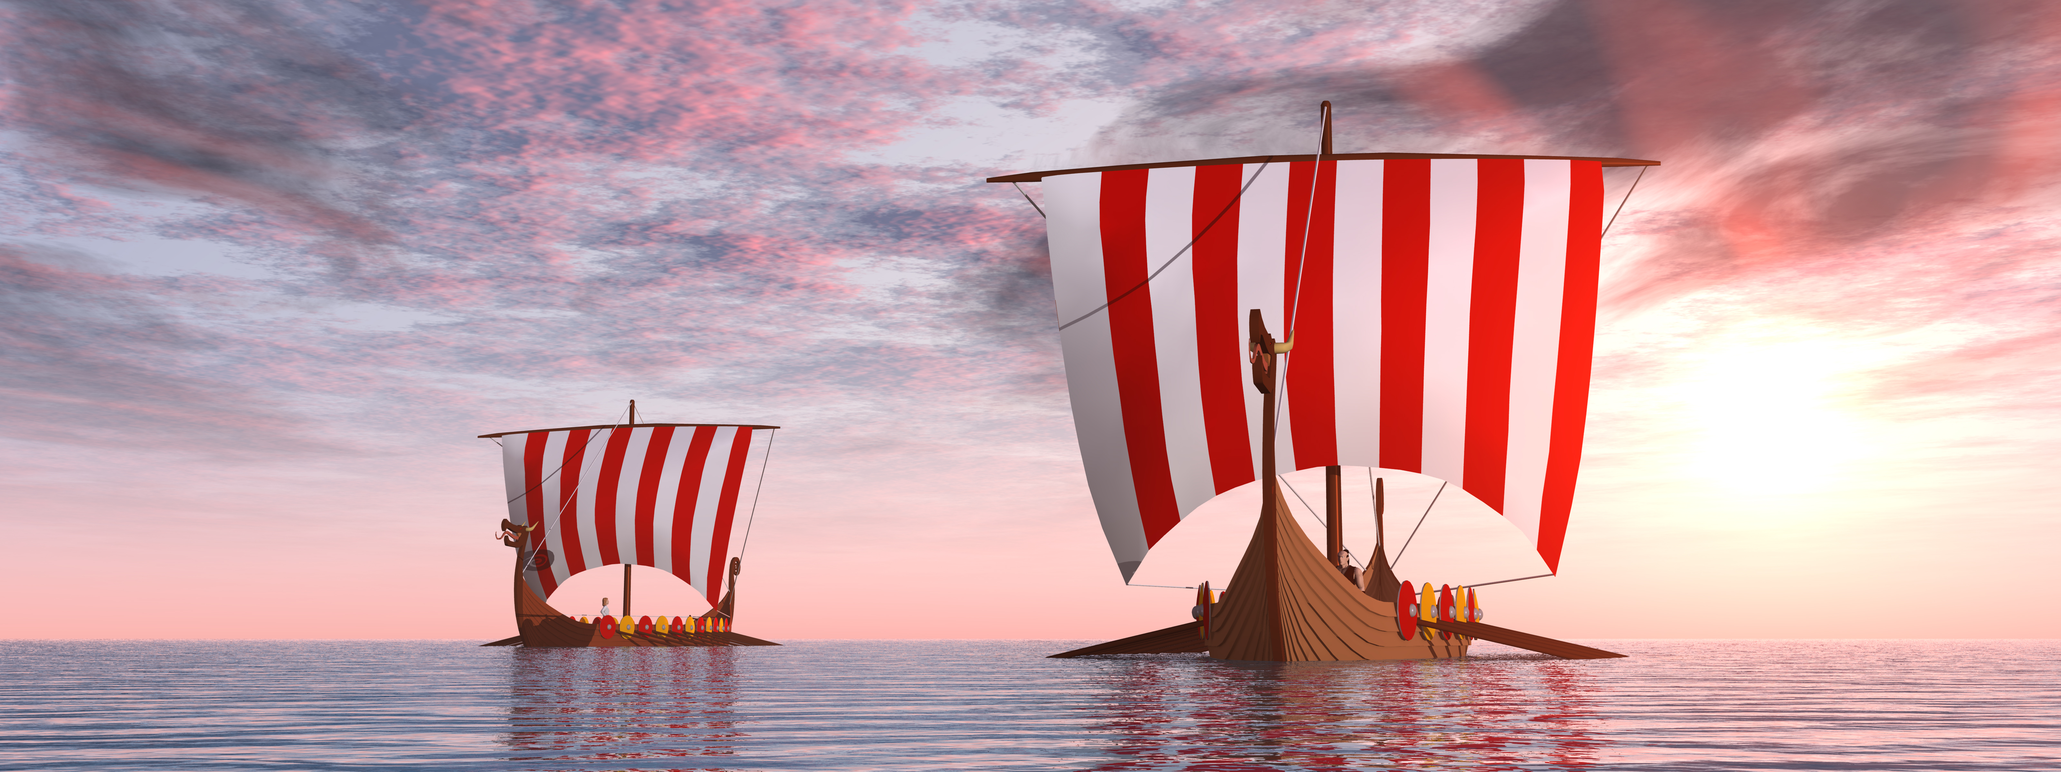
De kommer-They’re coming!
Publicize your event via:
Social media pages: your community’s page, Facebook, Instagram, For the event consider: Snapchat
Purchase a vinyl banner, and hang it over your community’s main thoroughfare
Use local press outlets, choose daily or weekly editions
Advertising shoppers may offer the same ads in numerous places for a lesser charge.
Post flyers.
Use your Chamber of Commerce connections for promotion.
Word of mouth advertising is powerful.

Slide 5
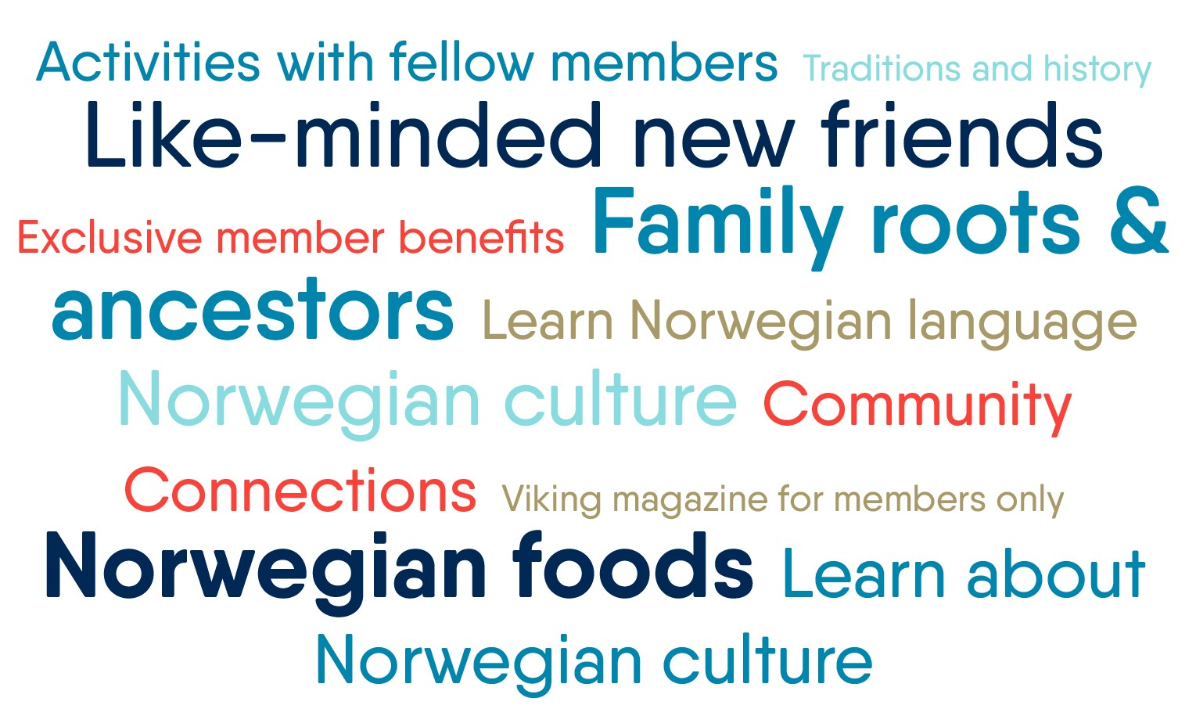
Why members LOVE their membership…

Slide 6
People keep a membership because it delivers the unique experience THEY want!
New opportunities to create shared experiences
Drive-thru events: Care packages, “at home” craft kits, community projects, take-away meals (lefse, anyone?). Don’t forget to include a “thank you” for being a member note of appreciation
Nonmeeting, Virtual Events: Happy hour, trivia games, music, book & genealogy gatherings, at home challenges and contests. Use the online Events listing at sofn.com.
Phone: Individual and small group calls by interest or topic
Social Media: Give plenty of notice of upcoming events, post reminders. Invite Facebook & Instagram updates showing member activities at home
Mail: Postcard exchanges between members and from lodge to members, renewal letters
Email: “Interloper” updates, joke of the day, activity & event reminders
Newsletter updates: Exceptional readership by members regardless of mail or email delivery!

Slide 7
Tweaking
Wait for the “all clear” from your county or state department of health before proceeding.
Check the availability of your meeting space for additional rules.
Evaluate your events and postpone to fall, if needed.
Consider holding outdoor lodge events in the summer.
Offer hybrid models of your meetings, if members request it.
Lodge liability could be a concern with events held during the COVID-19 pandemic timeframe.

Slide 8
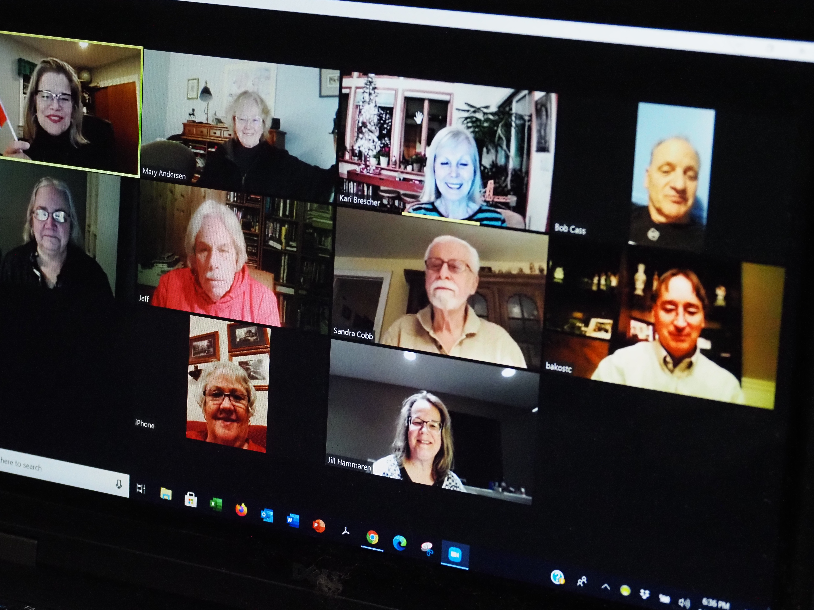
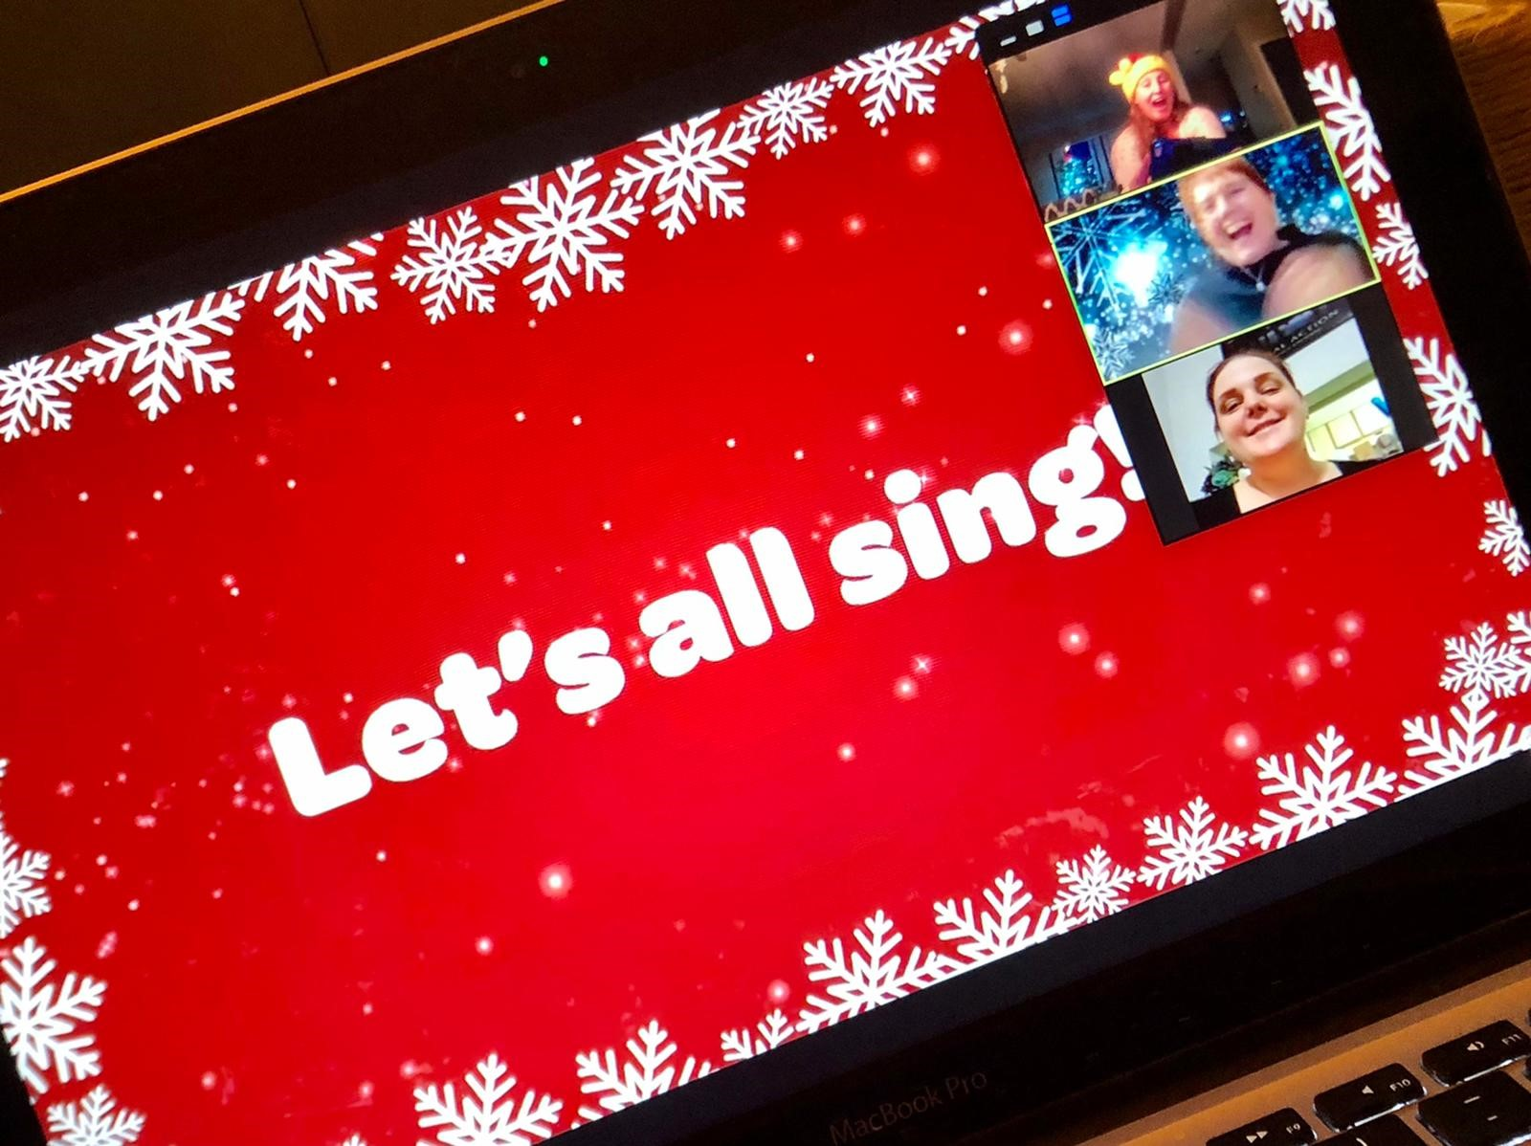
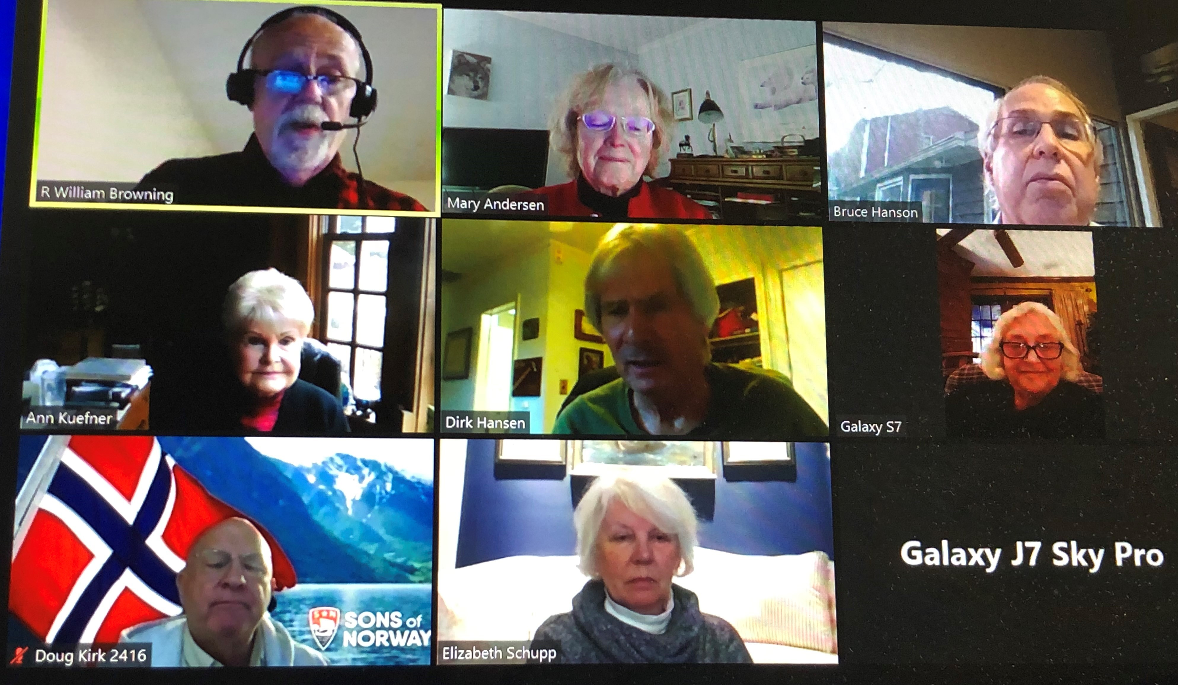
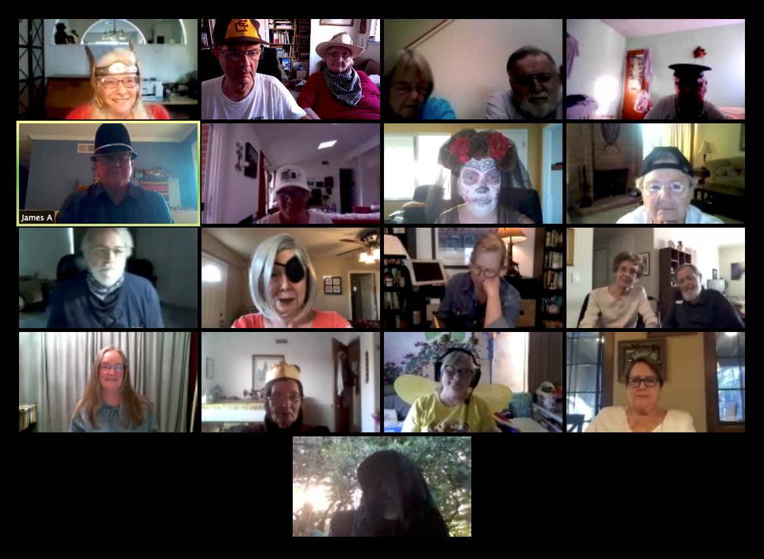
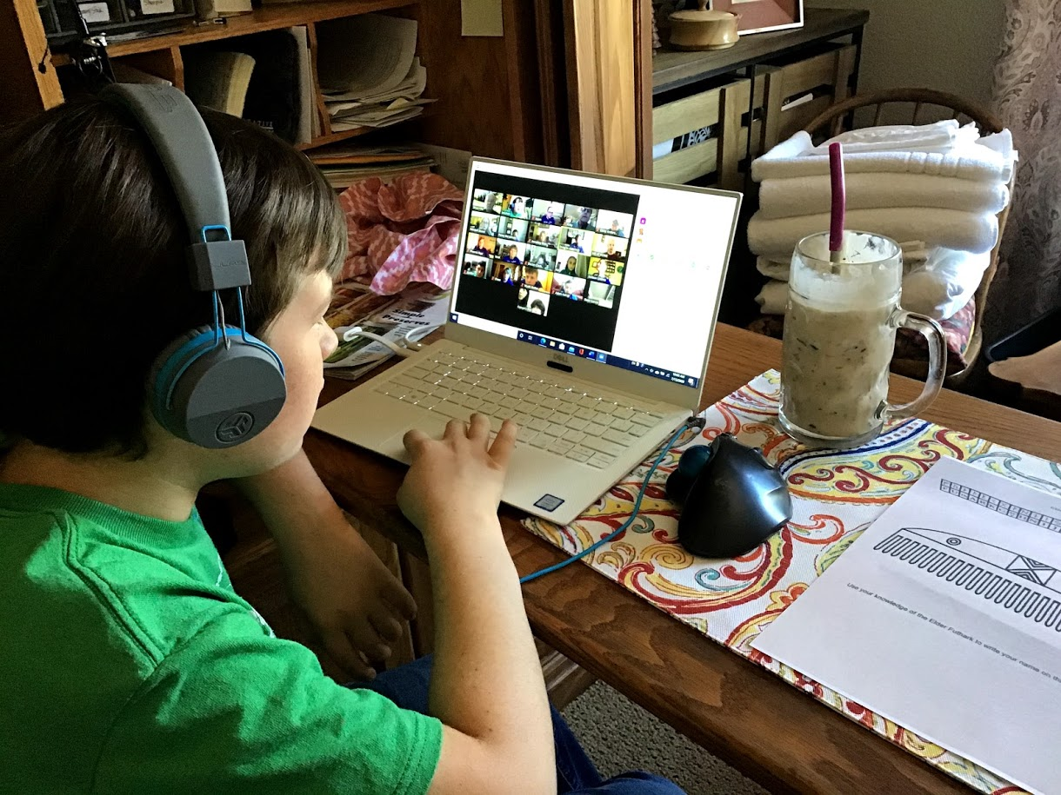
Virtual Gatherings
Are virtual meetings and activities here to stay?
Set the right expectations for attendance: Technology usage will continue in some form.
Keep it fresh & fun: Ideas to increase attendance--RSVP & gift drawing, promote an exciting speaker, send reminders, work with other lodges. Mix it up and see what works!
Pros & Cons: What is working, or not working for your members? ASK FOR MEMBER INPUT!

Slide 9
What new members tell us about their membership experience:
Engagement Initiatives
Friendly bunch, good food, fun to learn about Norwegian culture
Behind the scenes at headquarters…
New member onboarding emails: Welcome & introduction to exclusive member benefits, continuing since 2018
Renewing member “reboarding” emails: Confirming contact information with benefit updates and reminders, launched in 2021
Member Kits: Delivery of credentials and engagement “calls to action.” Ongoing, to new, renewing and heritage members
Virtual programs: More online content like The Blinding Sea, Coming Home videos in 2021
Active listening: New and renewing member surveys, member feedback to onboarding and reboarding
The combination of cultural and financial services is amazing.
Well organized web site; was reached out to immediately from local chapter upon joining
The staff is very friendly, and I am sure the members are just as nice, but a big thing for me is its MY heritage. I am Norwegian and Swede mostly and its really nice to find something that can teach my children about part of their heritage.

Slide 10
What’s working…
Drive-thru meals
On-line auctions
Social outdoor gatherings
Virtual scavenger hunts
Kubb leagues and practice sessions
Hikes in area parks or wetlands
Bird watching
Sports that your members enjoy: walking, pickleball, swimming, fishing
Bike rides on recreational trails
Road rallies
Advanced planning for fall offerings
Don’t wait! Make sure your lodge is sailing in the correct direction!

Slide 11
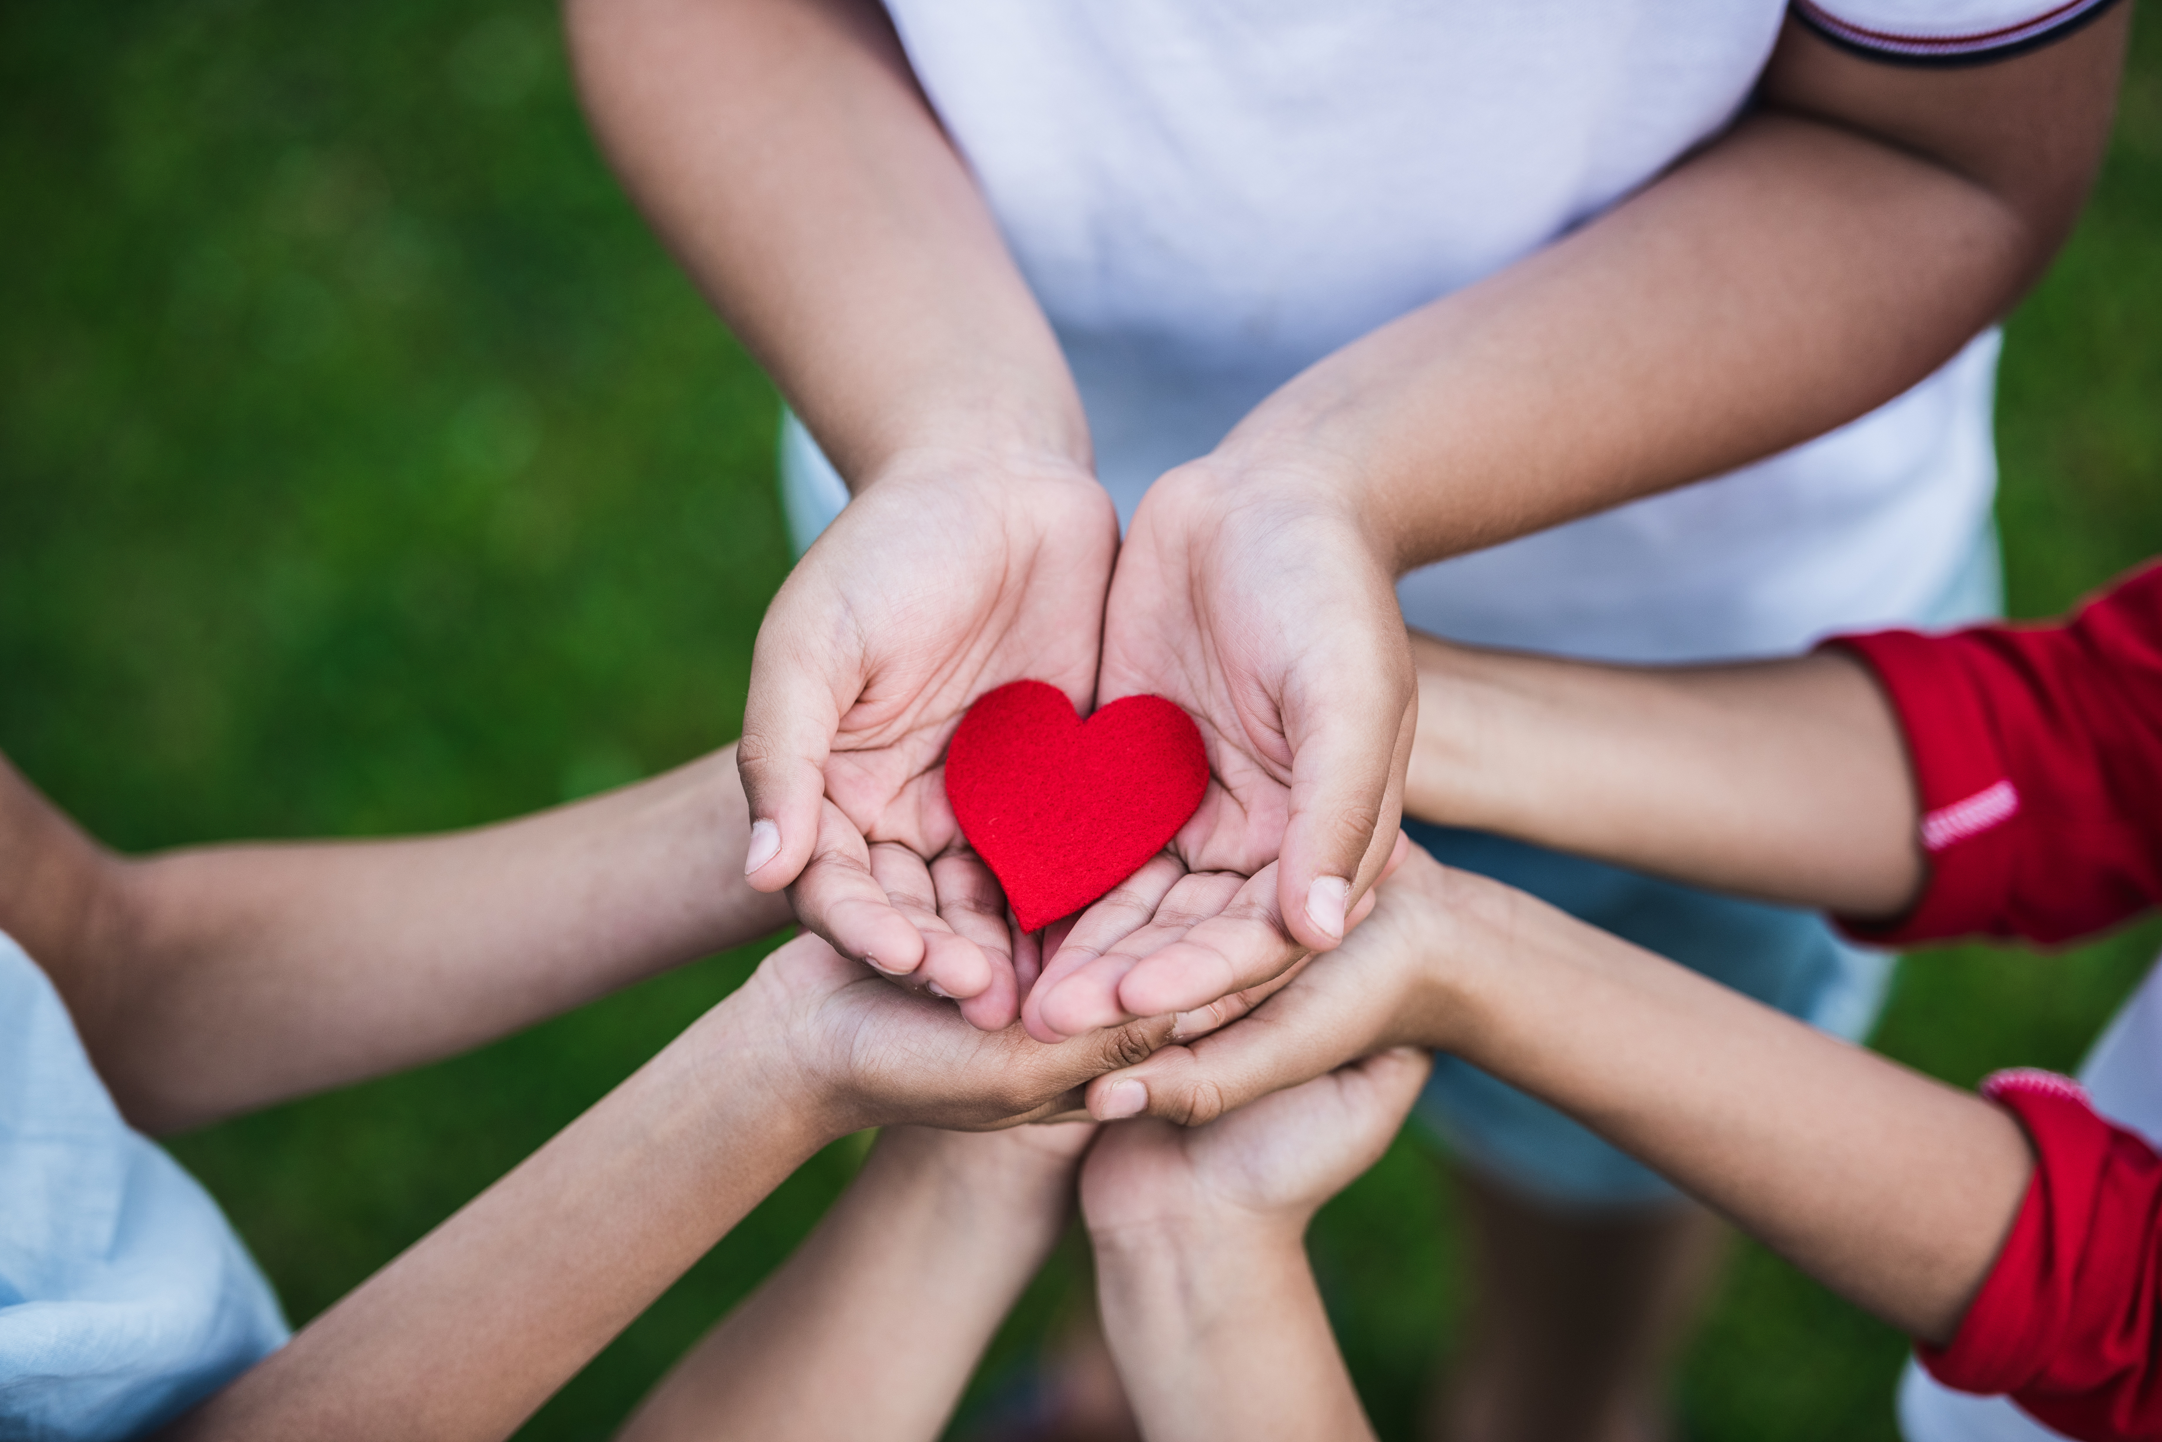
The dedication to your lodge and the support that has been given to your community will be remembered.
Know that your fellow members see your efforts, and they are appreciative.
Everything you do as a member leader for the 5th District does not go unnoticed!
*Please continue to share your lodge events on our Facebook page so that others can also experience success! TAKK.
Takk for hjelpen oss!

Slide 12
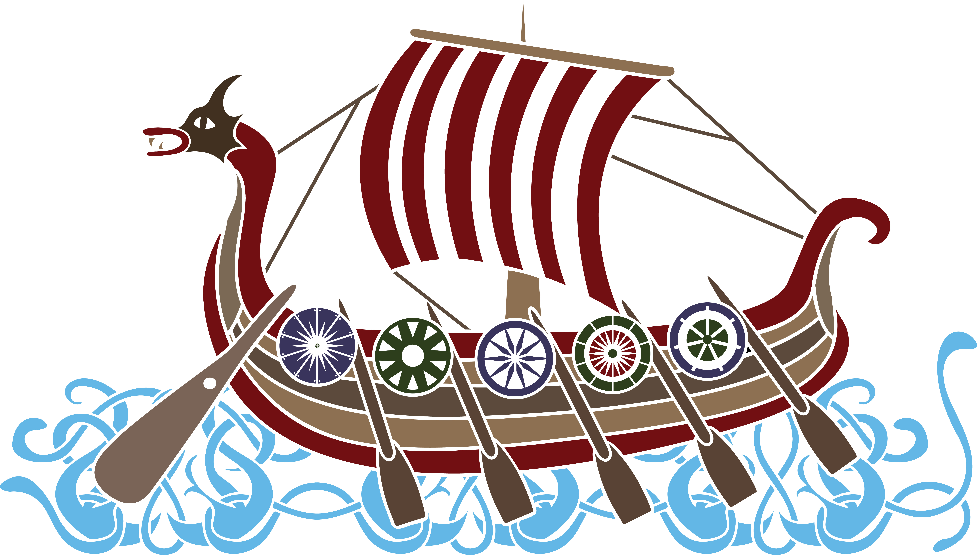
Need Further Assistance? Contact: Cheryl Wille-Schlesser District 5 Vice President 608-219-4464 rogrcher@mhtc.net

