Slide 1
Sons of Norway
Sports Medals

Slide 2
Sykkelmerke (Cycling)

Slide 3
Sykkelmerke record card

Slide 4
Sv0mmemerke (swimming)

Slide 5
Svommemerke record card

Slide 6
Skimerke (skiing)

Slide 7
Skimerke record card

Slide 8
Gangmerke (walking)

Slide 9
Gangmerke record card

Slide 10
Idrettsmerke (sports & fitness)

Slide 11
Idrettsmerke record card

Slide 12
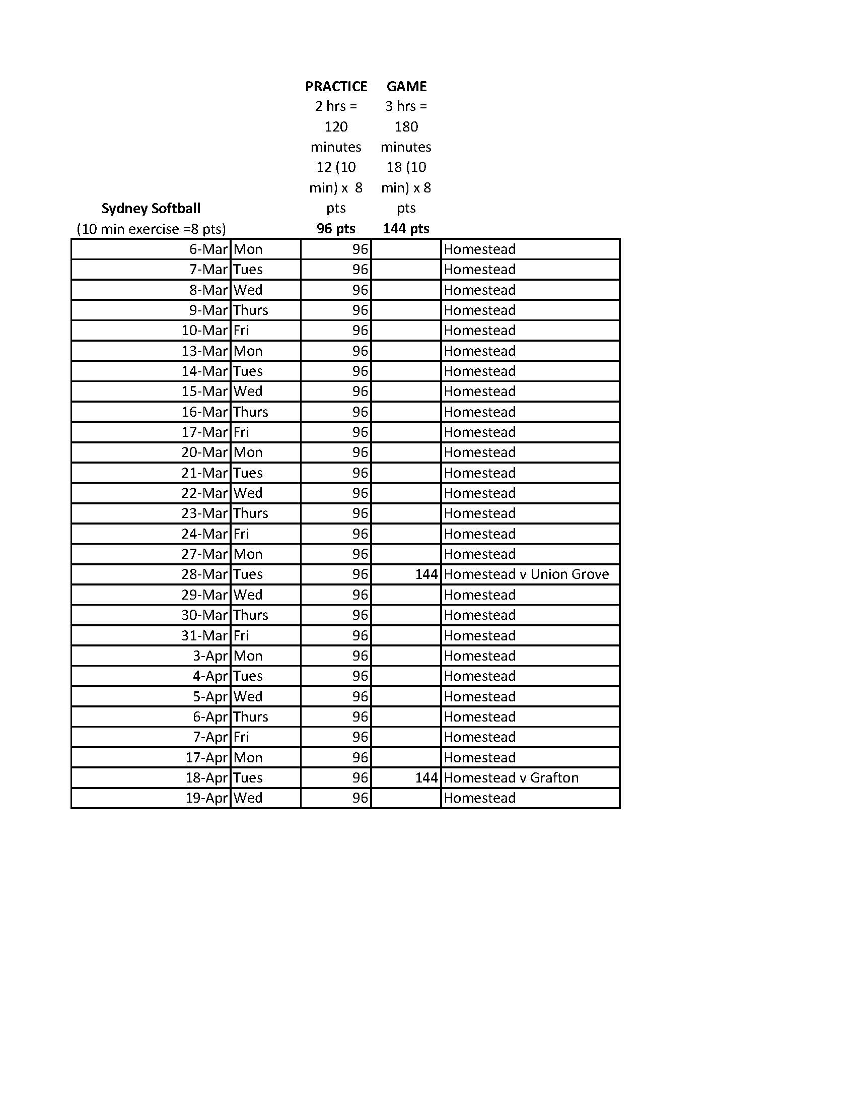
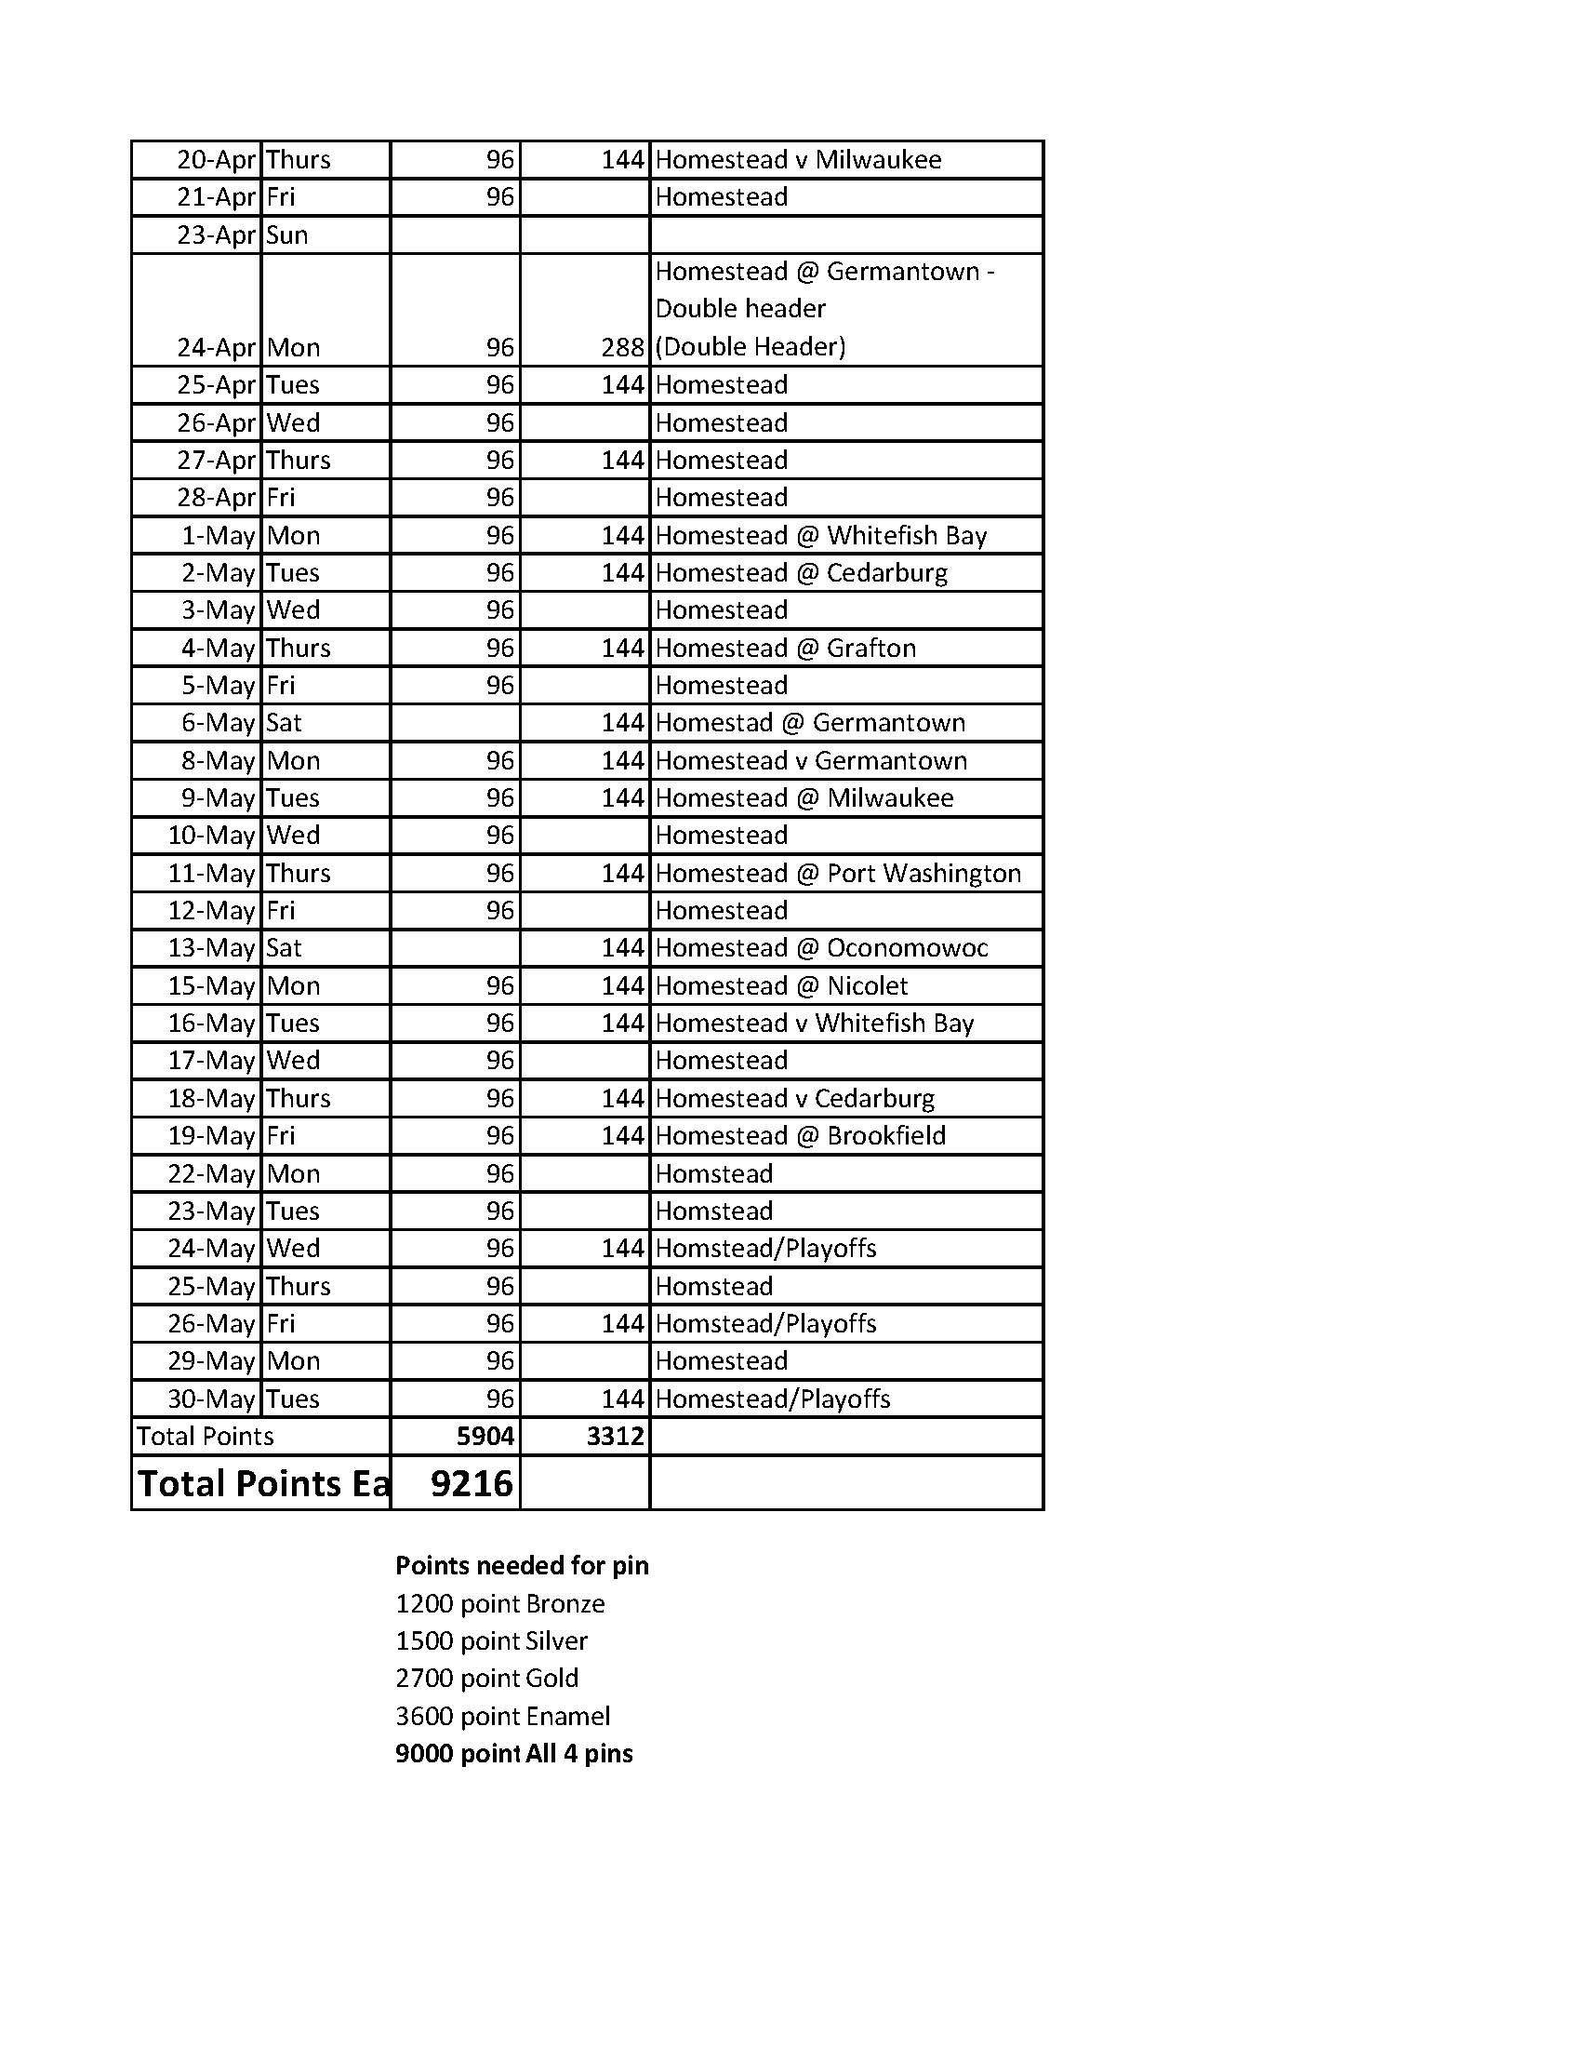
One way to track points
BASEBALL
In just one season this person actually earned ALL 4 pins in one season of baseball just by keeping track of practice and games!

Slide 13
